Slide 1
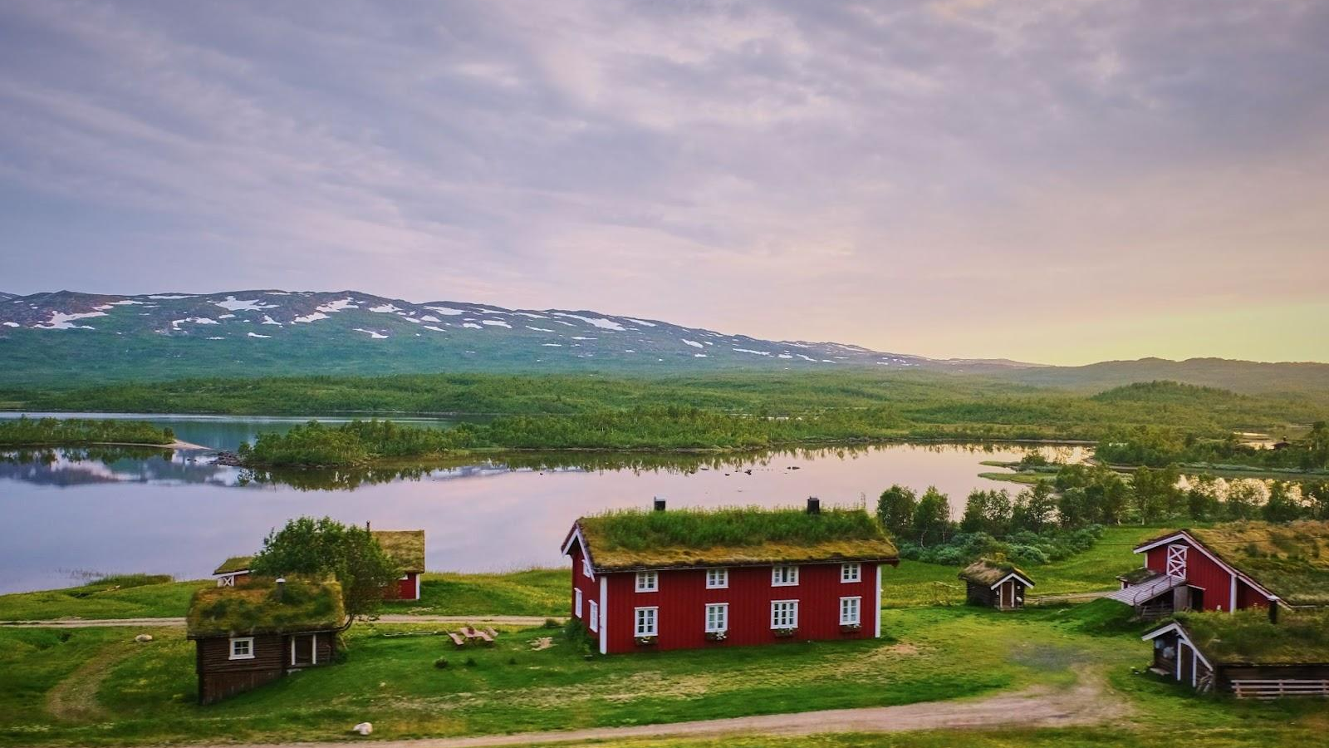

The state of open LLMs in Europe - the Nordic perspective
magnus.sahlgren@ai.se

Slide 2


Language models learn a probability distribution over language
magnus.sahlgren@ai.se
Image by kjpargeter on Freepik

Slide 3
Language models learn a probability distribution over language
Pretraining + finetuning (+ alignment)
magnus.sahlgren@ai.se
Image by kjpargeter on Freepik

Slide 4
Language models learn a probability distribution over language
Pretraining + finetuning (+ alignment)
General-purpose text processing abilities
magnus.sahlgren@ai.se
Image by kjpargeter on Freepik

Slide 5
Language models in Sweden
2017: the Transformer is introduced
2018: the first Transformer-based language models (GPT, BERT)
2019: language models for Swedish authorities
2020: the first LLM (GPT-3)
2021: the NLU-group at AI Sweden
2022: the first Scandinavian LLM: GPT-SW3
2023: validation and open models (incl GPT-SW3)
2024: better and MORE data, multimodality
European initiatives (EuroLingua-GPT, TrustLLM, DeployAI)
magnus.sahlgren@ai.se

Slide 6
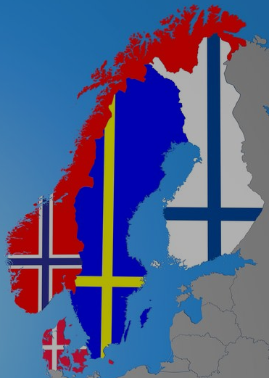
FinGPT
Viking
Poro
Ahma
NorLLM
GPT-SW3
magnus.sahlgren@ai.se

Slide 7
FinGPT
Viking
Poro
Ahma
NorLLM
GPT-SW3
magnus.sahlgren@ai.se

Slide 8
FinGPT
Viking
Poro
Ahma
NorLLM
GPT-SW3
Danish foundation models
magnus.sahlgren@ai.se

Slide 9
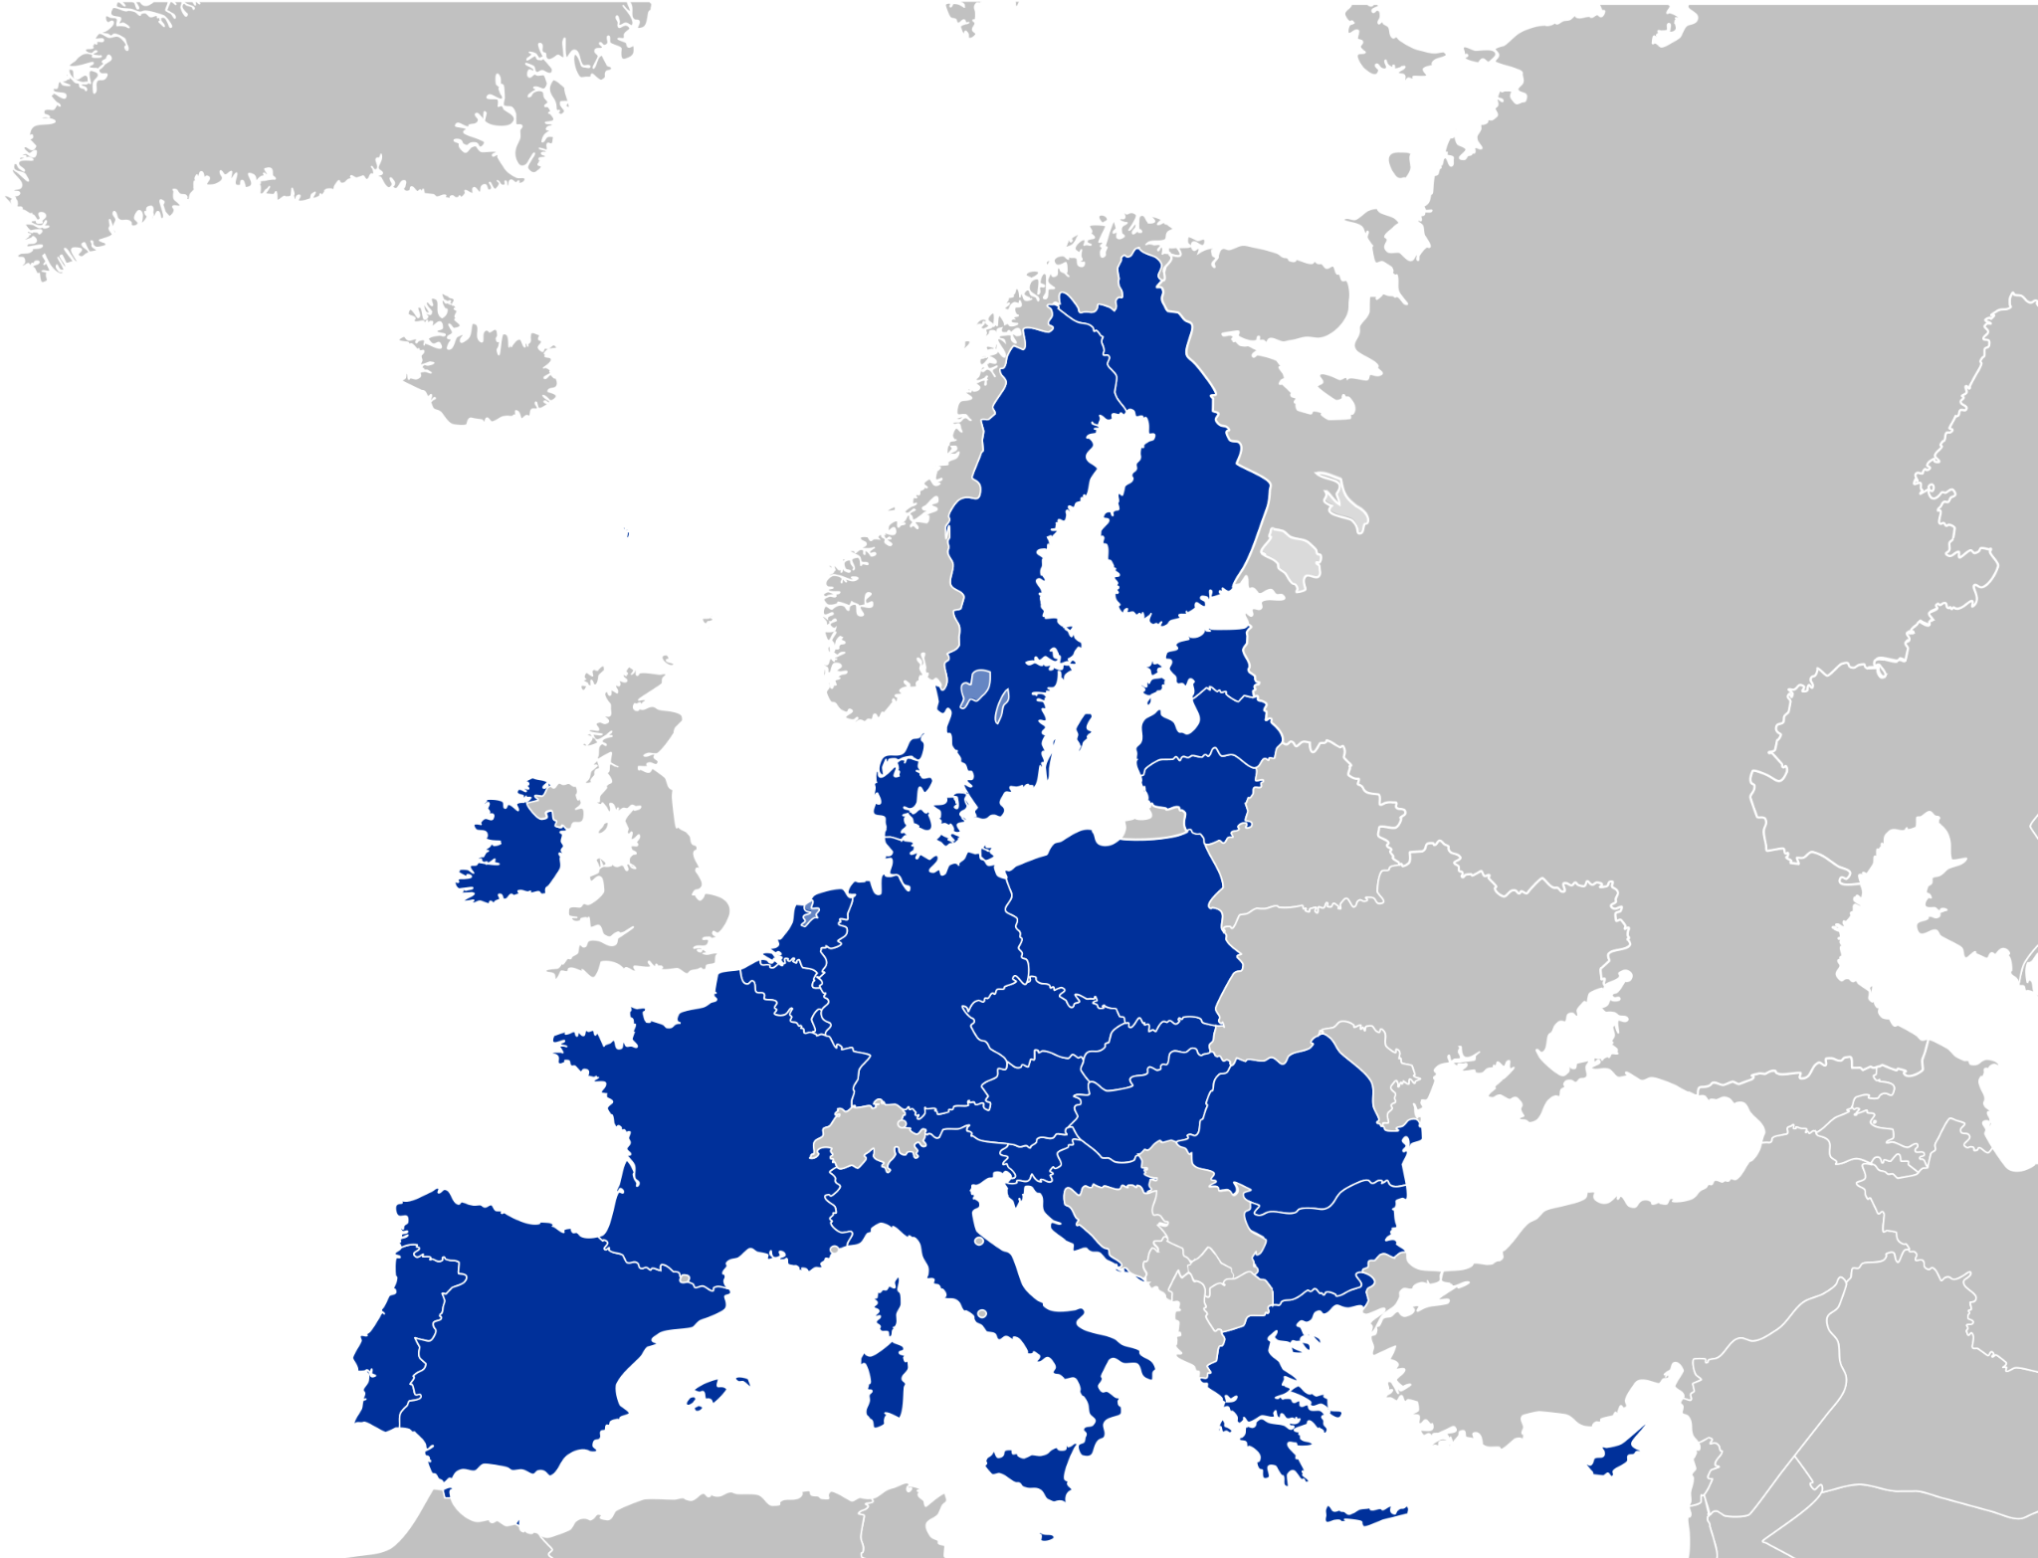

Fin-GPT
Viking
Poro
Ahma
NorLLM
GPT-SW3
BLOOM
Lyra-fr
CroissantLLM
Mistral
Mixtral
OpenGPT-X
magnus.sahlgren@ai.se

Slide 10
Fin-GPT
Viking
Poro
Ahma
NorLLM
GPT-SW3
BLOOM
Lyra-fr
CroissantLLM
Mistral
Mixtral
OpenGPT-X
magnus.sahlgren@ai.se

Slide 11
Fin-GPT
Viking
Poro
Ahma
NorLLM
GPT-SW3
BLOOM
Lyra-fr
CroissantLLM
Mistral
Mixtral
OpenGPT-X
magnus.sahlgren@ai.se

Slide 12
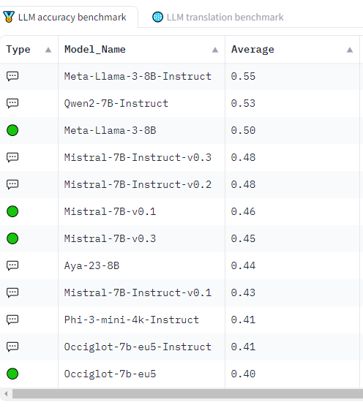
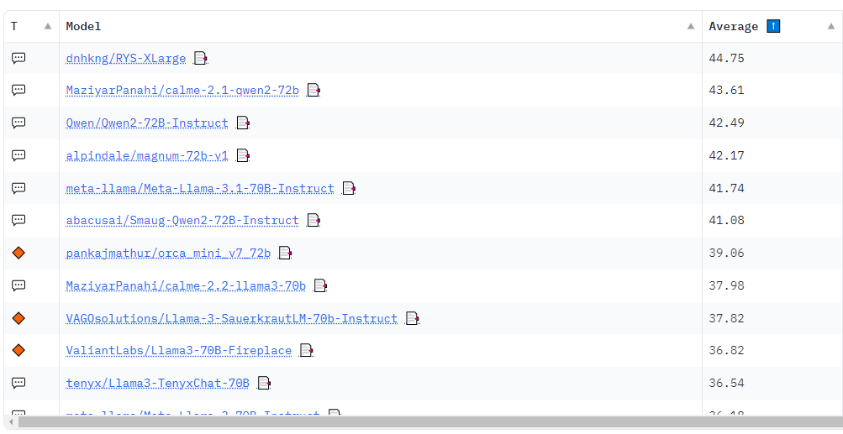
huggingface.co/spaces/openGPT-X/european-llm-leaderboard
huggingface.co/spaces/open-llm-leaderboard/open_llm_leaderboard

Slide 13

huggingface.co/spaces/openGPT-X/european-llm-leaderboard
huggingface.co/spaces/open-llm-leaderboard/open_llm_leaderboard

Slide 14
Why build national LLMs?
Competence and innovation
Transparency and representativity
Resilience and sovereignty
Democratization
magnus.sahlgren@ai.se

Slide 15
Why build national LLMs?
Competence and innovation
Transparency and representativity
Resilience and sovereignty
Democratization
Existing models are still not great on e.g. Swedish!
magnus.sahlgren@ai.se

Slide 16
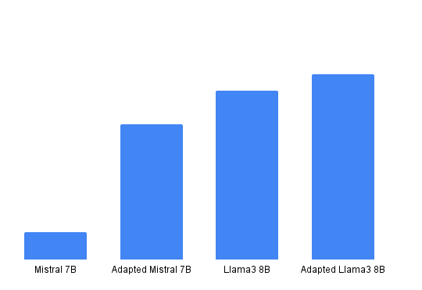
Adaptation of open models
scandeval.com
magnus.sahlgren@ai.se

Slide 17
Adaptation of open models
scandeval.com
magnus.sahlgren@ai.se

Slide 18
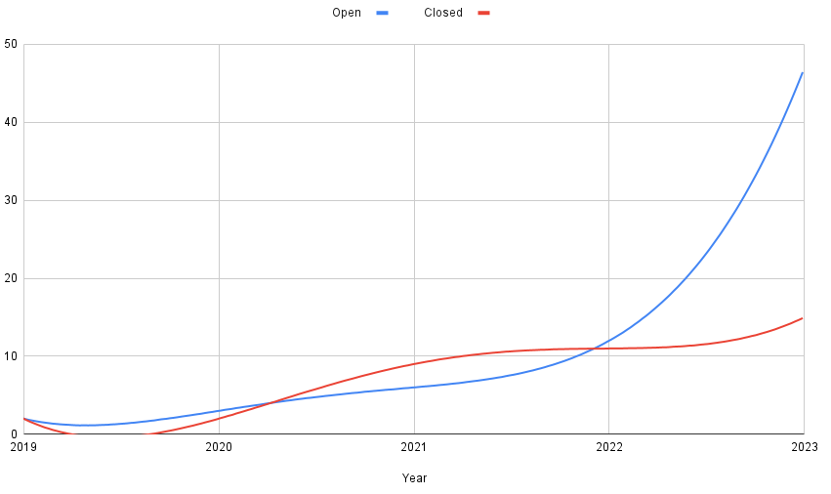
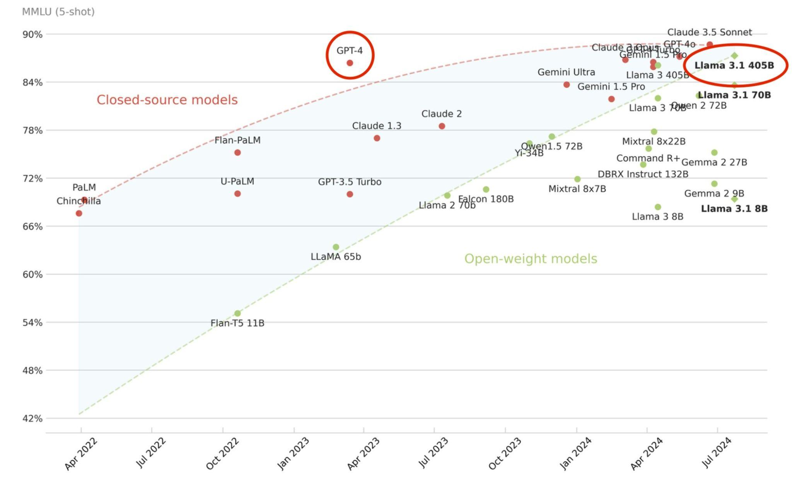
Open vs closed models
Data compiled by Stella Biderman
Maxime Labonne
magnus.sahlgren@ai.se

Slide 19
Competence
Data
Funding
Infrastructure
magnus.sahlgren@ai.se

Slide 20
Competence
Language models
Deep learning
HPC
Data
Funding
Infrastructure
magnus.sahlgren@ai.se

Slide 21
Competence
Language models
Deep learning
HPC
Data
Funding
Large-scale projects
Not research!
(The artefacts should be the goal)
Infrastructure
magnus.sahlgren@ai.se

Slide 22
Competence
Language models
Deep learning
HPC
Data
Trillions of high-quality tokens
(We need to be compliant with
European data protection policies)
Funding
Large-scale projects
Not research!
(The artefacts should be the goal)
Infrastructure
magnus.sahlgren@ai.se

Slide 23
Competence
Language models
Deep learning
HPC
Data
Trillions of high-quality tokens
(We need to be compliant with
European data protection policies)
Funding
Large-scale projects
Not research!
(The artefacts should be the goal)
Infrastructure
1000s of high-end GPUs
(with good interconnect)
Large-scale allocations
magnus.sahlgren@ai.se

Slide 24
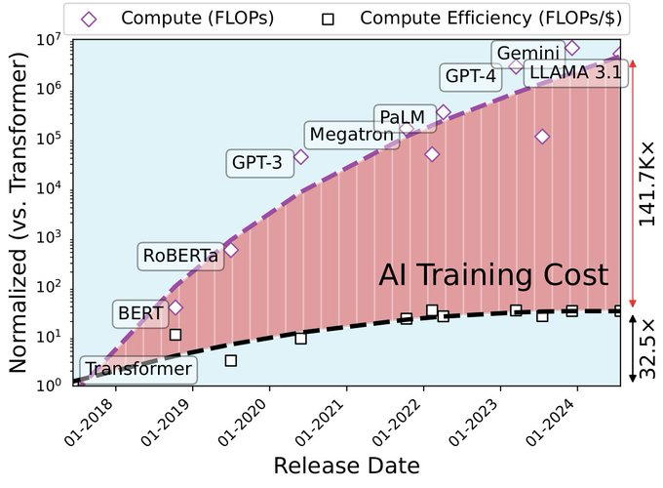
Adi Fuchs
magnus.sahlgren@ai.se

Slide 25
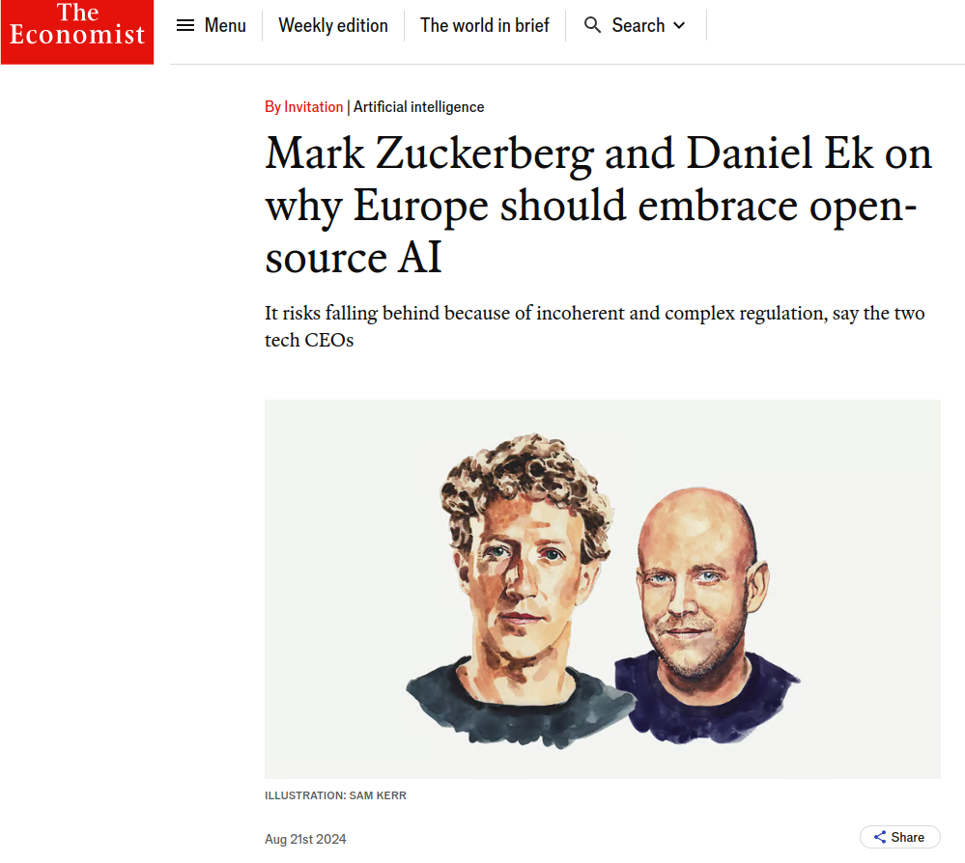
www.economist.com/by-invitation/2024/08/21/mark-zuckerberg-and-daniel-ek-on-why-europe-should-embrace-open-source-ai
magnus.sahlgren@ai.se

Slide 26
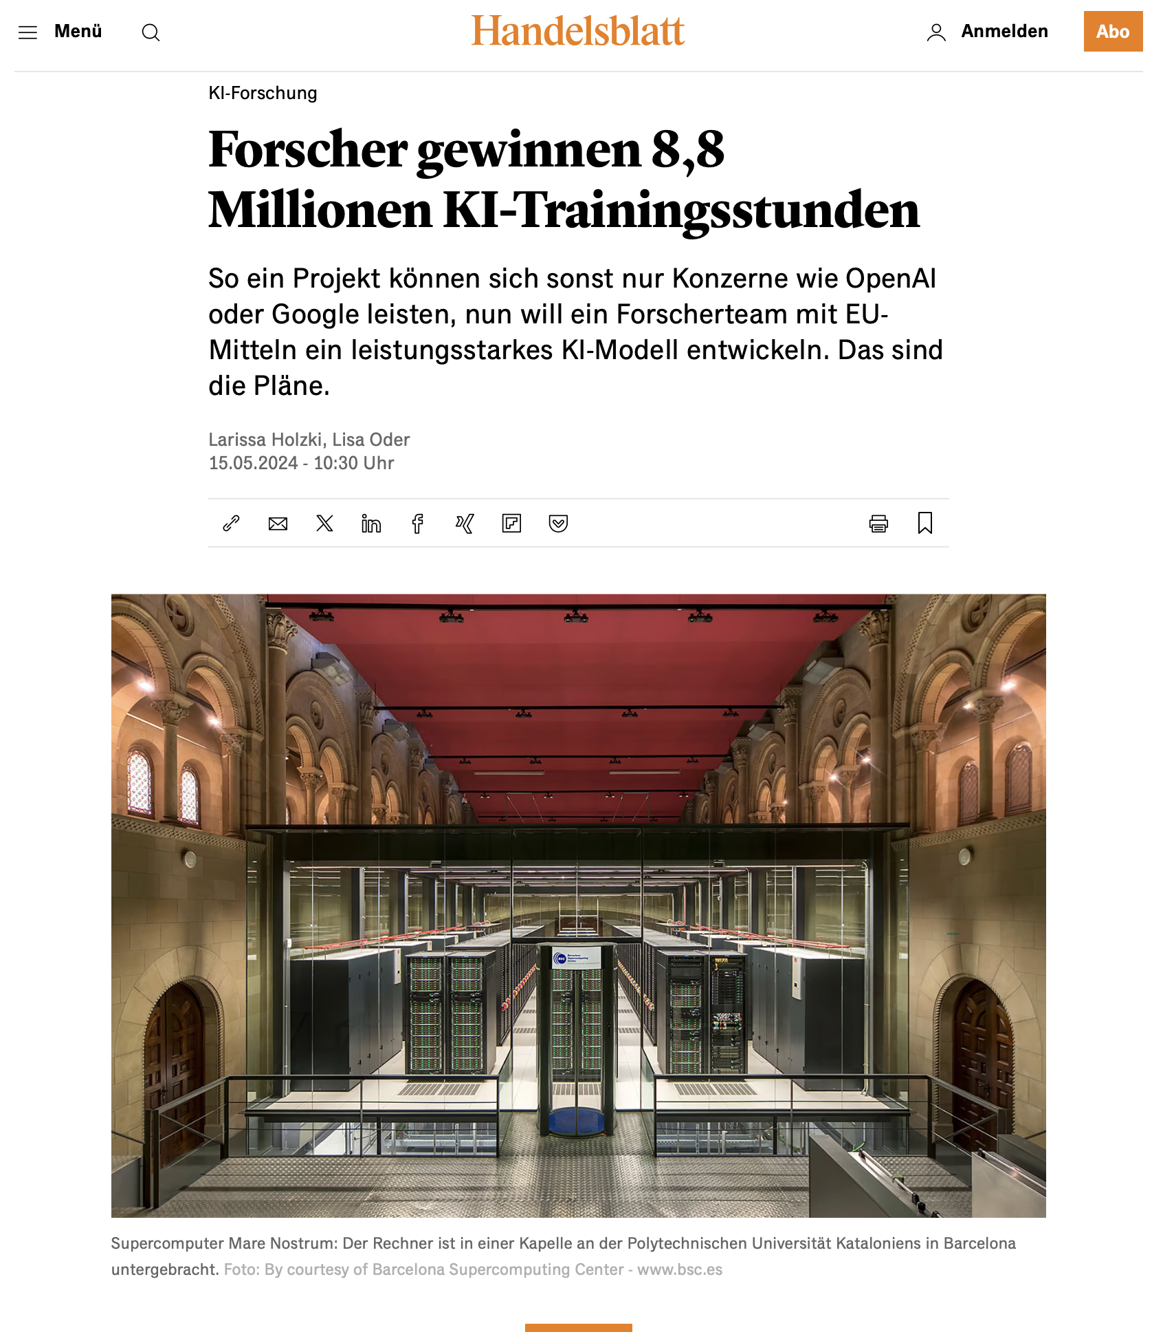
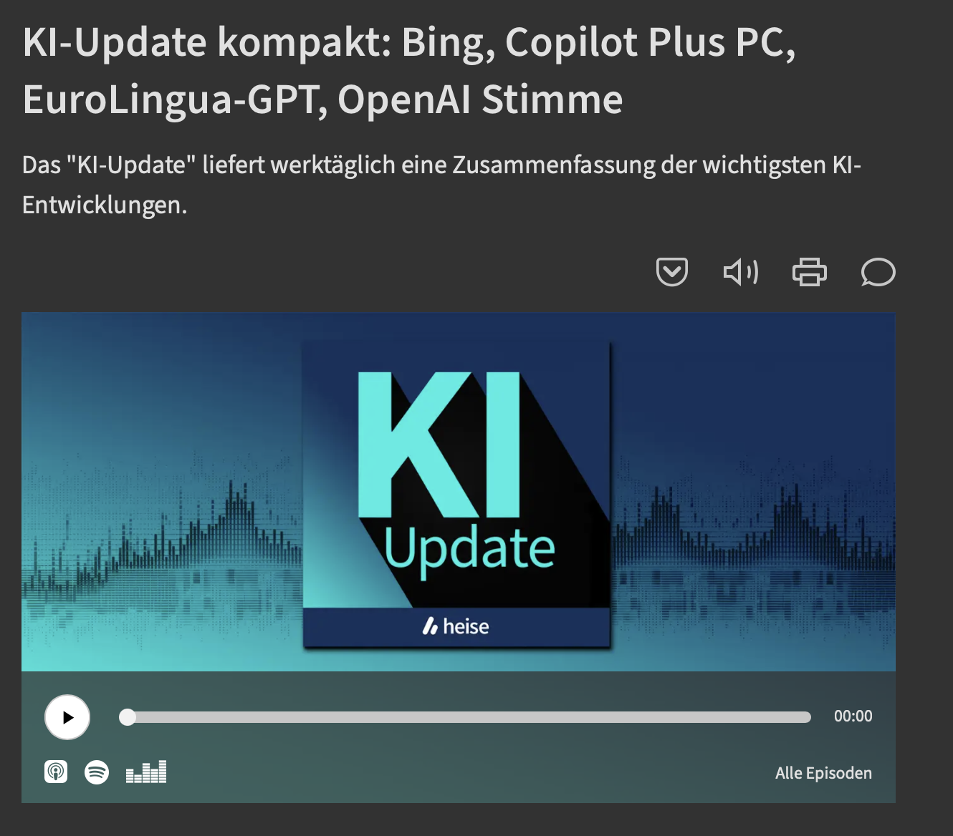
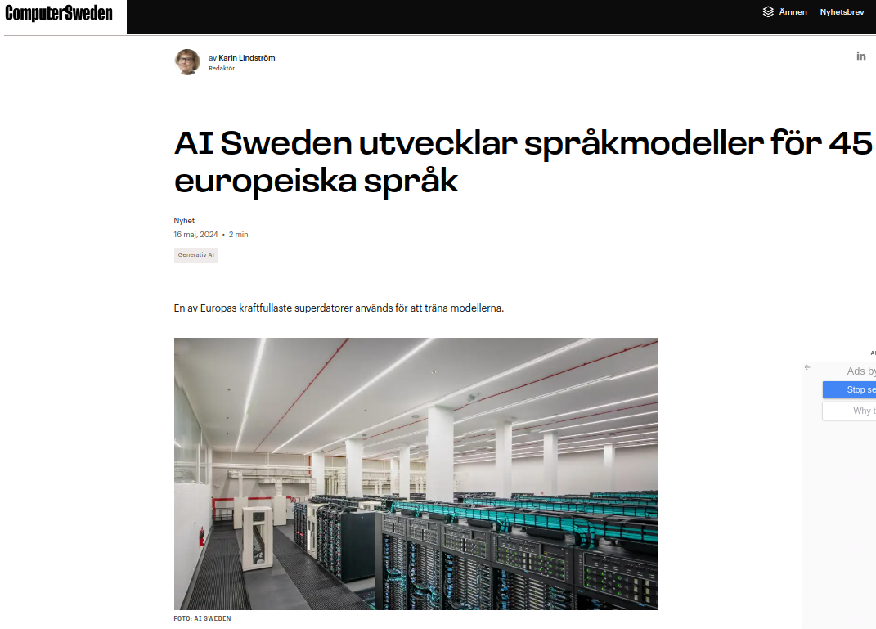

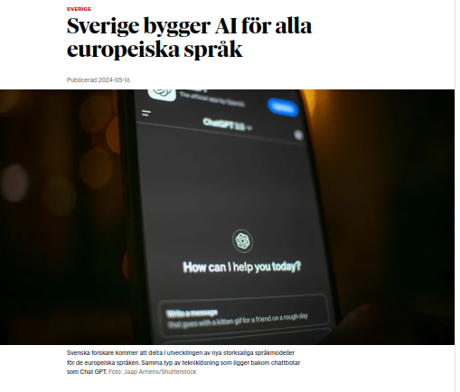
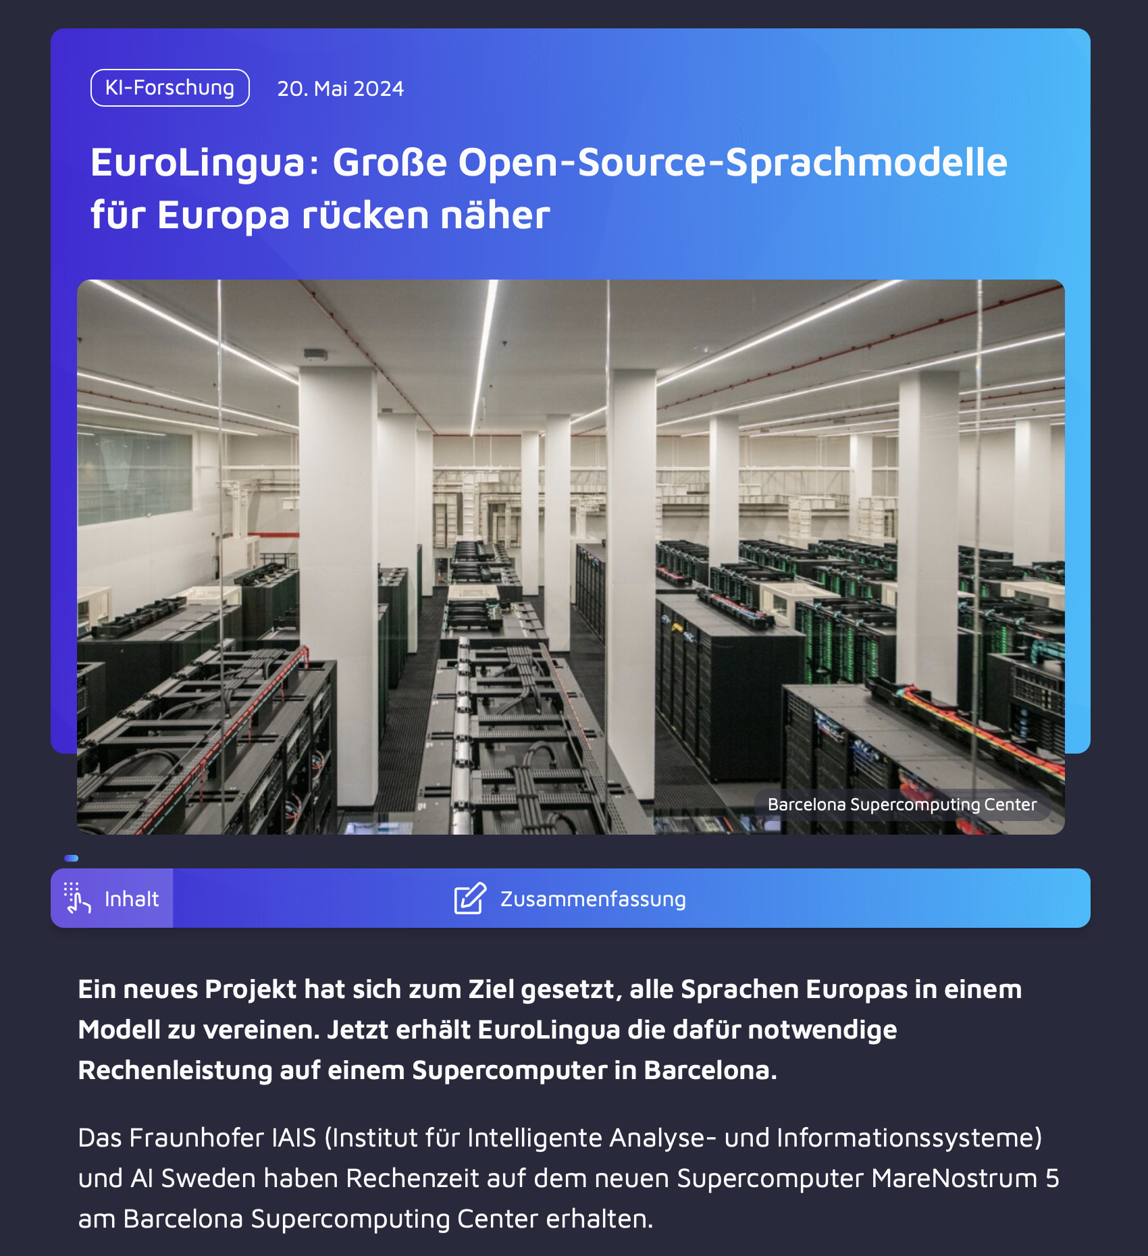
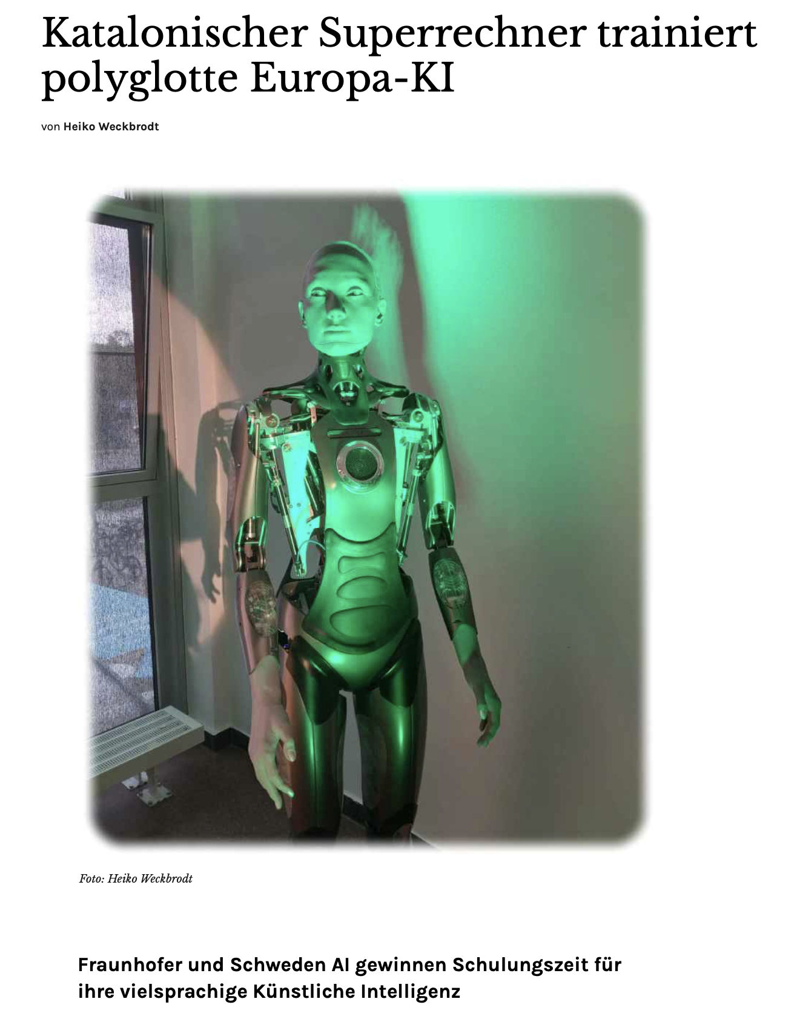
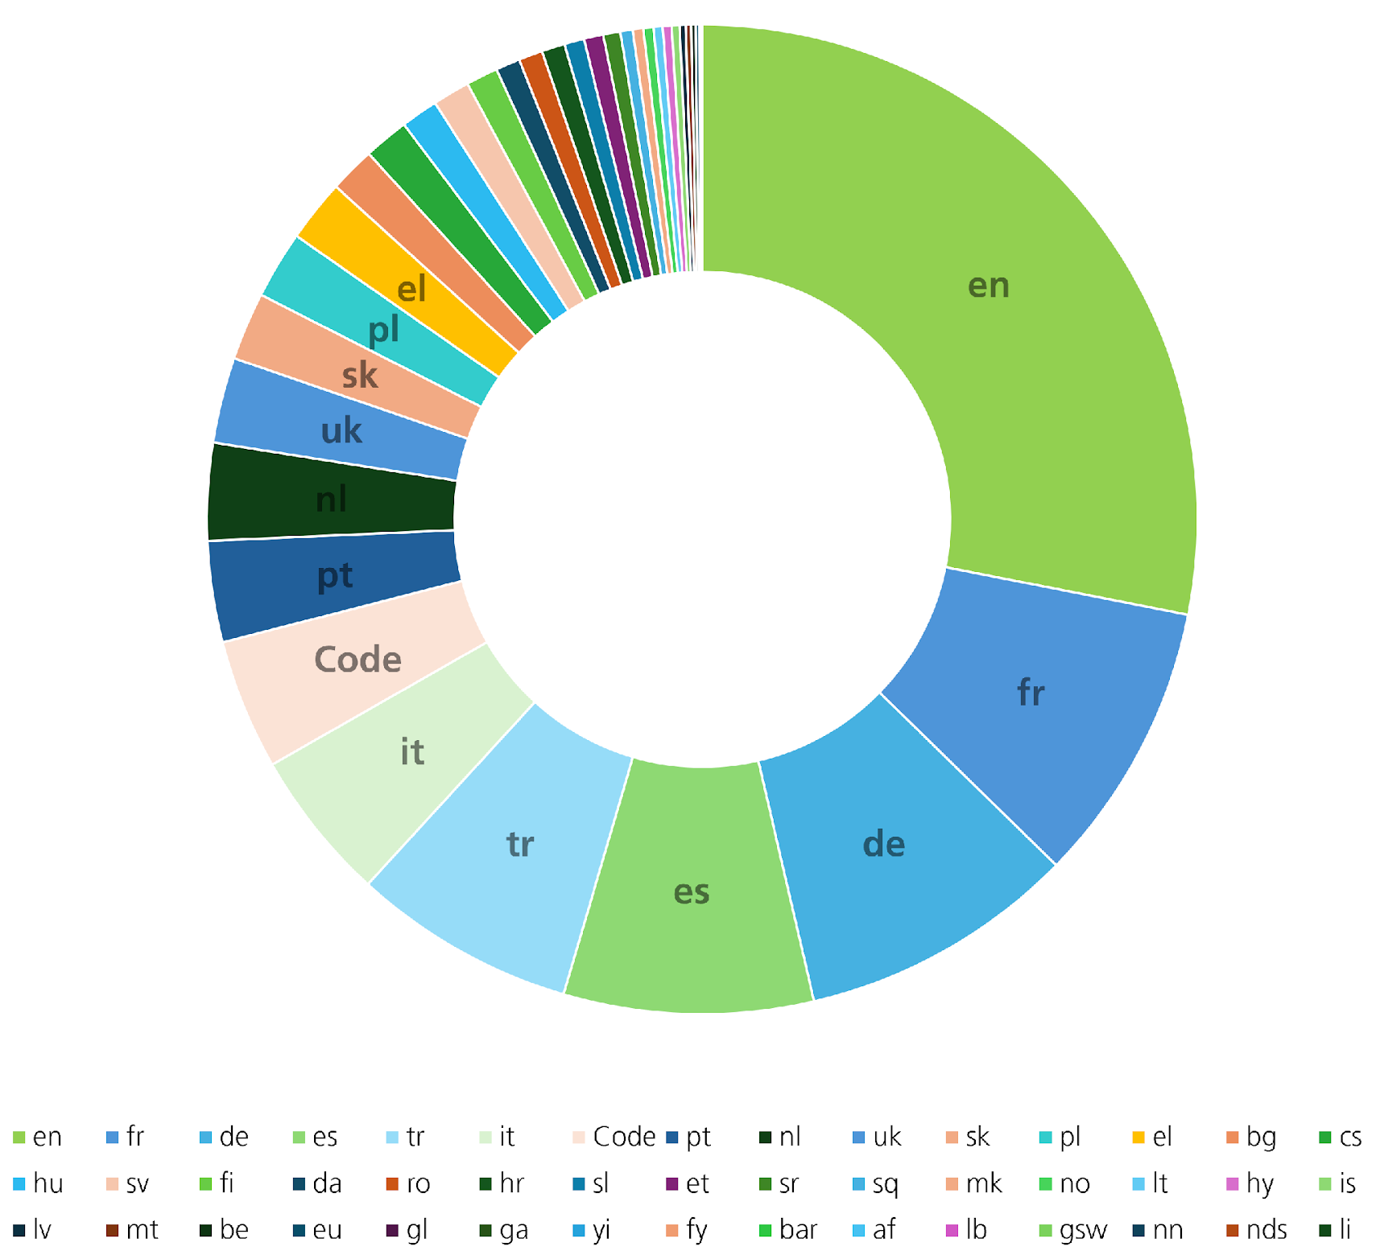
EuroLingua-GPT
A new and open foundation model for the European languages
Collaboration between AI Sweden and Fraunhofer IAIS
MareNostrum5: 4480 H100 GPUs
(extreme-scale allocation)
magnus.sahlgren@ai.se

Slide 27
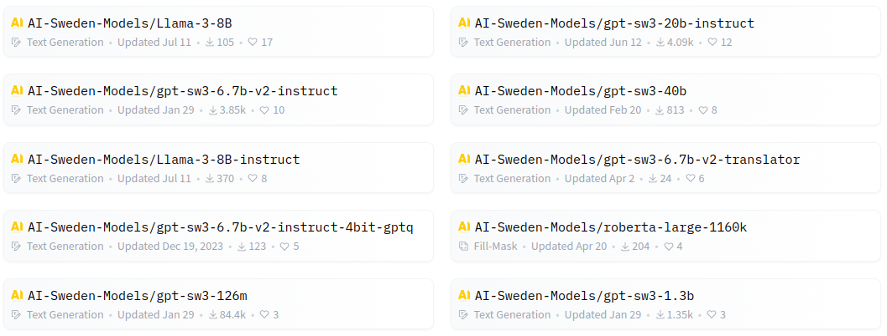
huggingface.co/AI-Sweden-Models
magnus.sahlgren@ai.se

